Slide 1

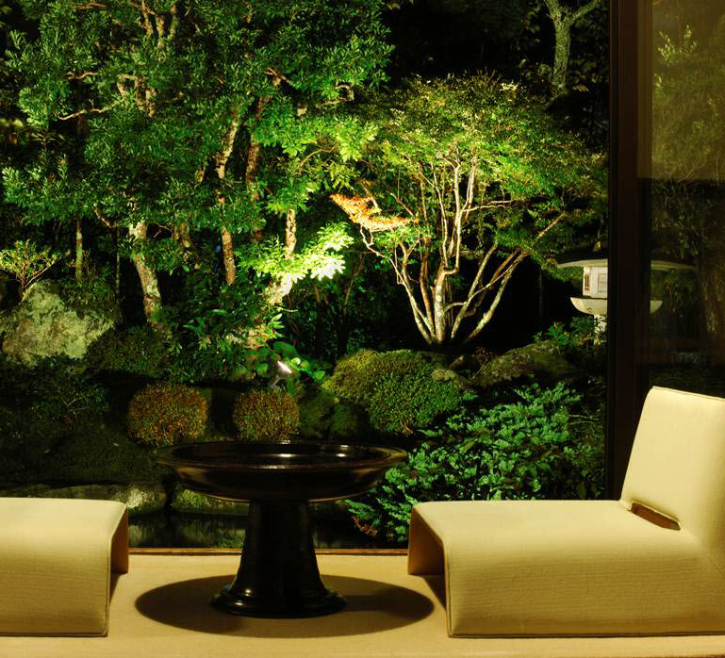

Creating Beautiful Outdoor Spaces
Jason Andrews, Sales Associate

Slide 2
Our Services
Garden center
Tree nursery
Gift shop
Delivery and installation
Patios and irrigation systems

Slide 3
Available Products
Shrubs, perennials, annuals
Soils and mulches
Garden décor including fountains
Shade trees and evergreen screening trees
Flowering or ornamental trees
Trees and plants for Christmas

Slide 4
We Make It Easy
We can do the entire project or we can assist
You can do as much, or as little, as you like
We will provide:
Landscape design planning or just advice
Soil testing
Low-cost delivery
Fountain set up

Slide 5
Why Sustainable Design?
Energy efficiency increased
Water efficiency increased
Dependency on chemicals decreased
Vigor assured through native and hardy plants

Slide 6
Call for a Consultation
615-792-8833

